Slide 1

Project based learning
On
Analysis and Design of G+5 Residential building using STAAD pro software
BACHELOR OF TECHNOLOGY
IN
DEPARTMENT OF CIVIL ENGINEERING
(2024-2028)
Submitted by
NAIKOTI SIRISHA (24X01A0124)
MAREGAMMA RENUKA (24X01A0122)
KALLEM SPOORTHI (24X01A0118)
BOLLU PRAVEEN (24X01A0105)

Slide 2
The construction industry has experienced significant advancements in structural engineering through the use of computer-aided analysis and design software. The analysis and design of multi-storey residential buildings require careful consideration of structural safety, stability, durability, economy, and serviceability. A G+5 residential building consists of a ground floor and five upper floors, making it essential to evaluate the structure under various loading conditions to ensure its safe and efficient performance.
The main objective of this project is to analyze and design a G+5 residential building using STAAD.Pro software. STAAD.Pro is a structural analysis and design software widely used by civil and structural engineers to model building structures, apply loads, analyze structural behavior, and design structural members. The software helps determine important structural parameters such as bending moments, shear forces, axial forces, support reactions, and deflections.
In this project, a three-dimensional structural model of the G+5 residential building is developed using STAAD.Pro. The building components, including beams, columns, slabs, and supports, are modeled based on the proposed architectural layout. The material properties of concrete and steel are assigned, and appropriate loads are applied to the structure. These loads generally include dead loads, live loads, and wind or seismic loads, depending on the building location and applicable design requirements. Suitable load combinations are considered in accordance with relevant Indian Standard (IS) codes.
Introduction

Slide 3
Problem Statement
Analysis and Design of G+5 Residential building using STAAD pro software
● The main problem addressed in this project is the analysis and design of a G+5 residential building using STAAD.Pro software to ensure structural safety, stability, durability, and economy. The building must be designed to withstand various loads, including dead loads, live loads, wind loads, and seismic loads, as applicable, in accordance with relevant Indian Standard (IS) codes.
● The project involves developing a three-dimensional structural model, applying appropriate loading conditions, analyzing the structural response, and designing the major structural elements, such as beams and columns. The analysis results are used to determine bending moments, shear forces, axial forces, support reactions, and deflections. Based on these results, the structural members are designed to satisfy strength and serviceability requirements.
● The ultimate aim is to achieve a safe, stable, and economical structural design for the G+5 residential building using STAAD.Pro while ensuring compliance with applicable design standards and engineering practices.

Slide 4
Objectives
● To model a G+5 residential building using STAAD.Pro software.
● To calculate and apply loads acting on the building.
● To analyze the structure under different loading conditions.
● To determine bending moments, shear forces, and deflections.
● To design beams and columns as per relevant IS codes.
● To ensure the safety and stability of the building.
● To achieve an economical and efficient structural design.

Slide 5
Proposed Methodology
1. Selection of Structure: Select a G+5 residential building with suitable floor heights, spans, column spacing, and preliminary structural dimensions.
2. Structural Modelling: Create a 3D building model in STAAD.Pro by defining nodes, beams, columns, floor levels, and member connectivity.
3. Assignment of Properties and Loads: Assign material properties, cross-sectional dimensions, support conditions, and apply dead loads, live loads, wind loads, and seismic loads as applicable.
4. Structural Analysis: Run the analysis in STAAD.Pro to calculate support reactions, shear forces, bending moments, axial forces, and nodal displacements.
5. Results Interpretation and Design: Evaluate the analysis results, design beams and columns, verify structural safety and serviceability, and prepare the final structural drawings and project report.

Slide 6
Tools and Technologies
1. STAAD.Pro Software: Used for 3D structural modelling, analysis, and design of the G+5 residential building.
2. AutoCAD: Used for preparing architectural plans, structural layouts, and detailing drawings.
3. Microsoft Excel: Used for load calculations, design calculations, and organizing analysis results.
4. IS Codes: IS 456, IS 875, and IS 1893 are used as applicable for concrete design, loading, and earthquake-resistant design.
5. RCC Technology: Reinforced Cement Concrete (RCC) is used for designing beams, columns, slabs, and foundations to ensure structural strength and stability.

Slide 7
Results
1. A 3D structural model of the G+5 residential building was developed using STAAD.Pro software.
2. Dead loads, live loads, wind loads, and seismic loads were applied as per the project requirements.
3. Structural analysis was performed to obtain support reactions, shear forces, bending moments, axial forces, and nodal displacements.
4. Beams and columns were evaluated for strength, stability, and serviceability, and the required reinforcement was determined.
5. The analysis and design results provide a basis for achieving a safe, stable, and economical residential building, subject to verification of the actual design calculations and applicable IS codes.

Slide 8
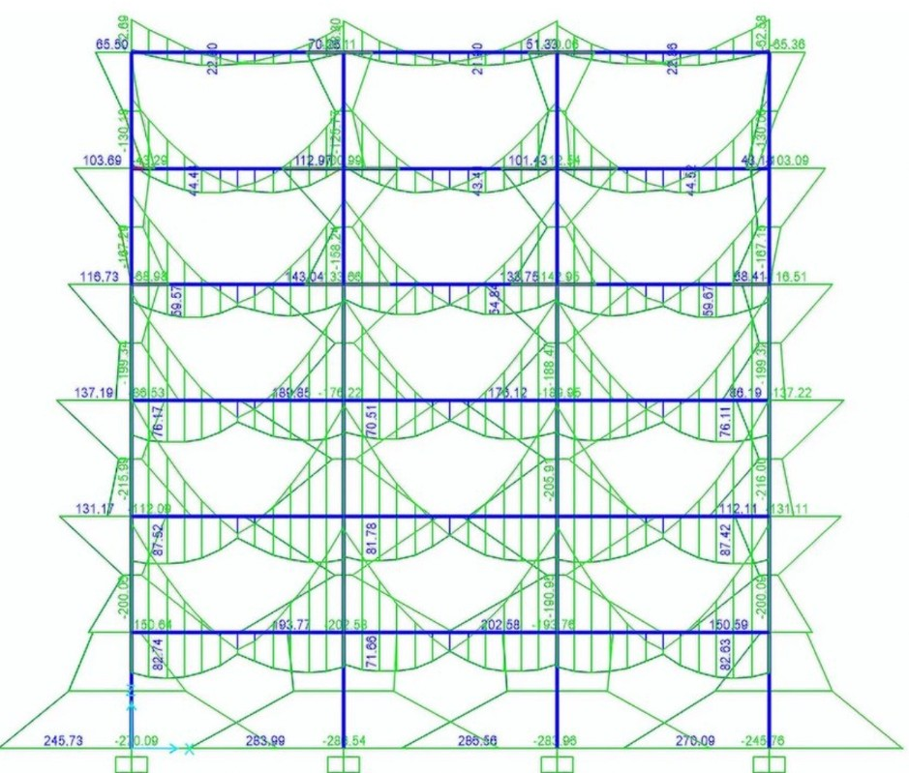
Bending moment diagram

Slide 9
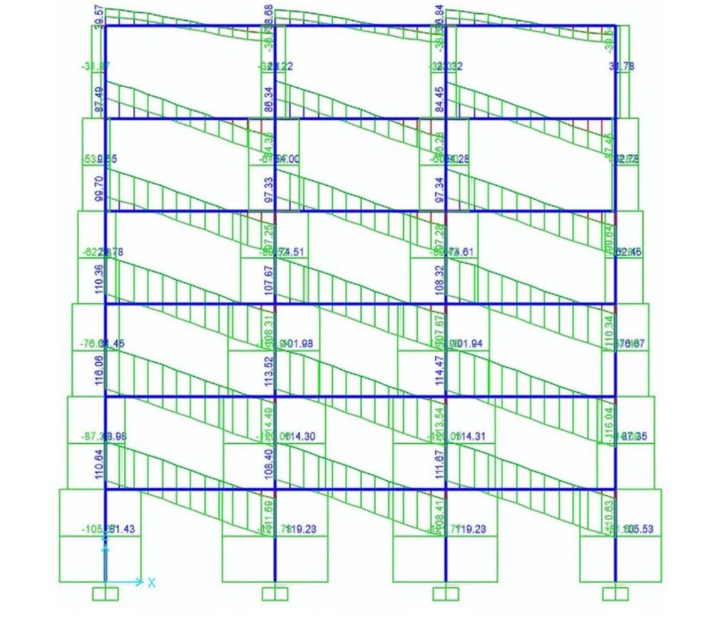
Shear force diagram

Slide 10
Conclusion
The analysis and design of the G+5 residential building were carried out using STAAD.Pro software. The 3D structural model was developed, and the relevant loads were applied to evaluate the structural behaviour. Support reactions, shear forces, bending moments, axial forces, and displacements were obtained through structural analysis. The results help in designing suitable beams and columns to ensure structural safety, stability, and serviceability. Thus, STAAD.Pro is an effective tool for the analysis and design of multi-storey residential buildings.

Slide 11
References
1. IS 456:2000 – Plain and Reinforced Concrete – Code of Practice, Bureau of Indian Standards (BIS).
2. IS 875 (Parts 1–5) – Code of Practice for Design Loads (Other Than Earthquake) for Buildings and Structures, BIS.
3. IS 1893 (Part 1) – Criteria for Earthquake Resistant Design of Structures, BIS (applicable edition).
4. Bentley Systems – STAAD.Pro Structural Analysis and Design Software Documentation.
5. AutoCAD Documentation – Autodesk, for structural drafting and detailing. 6. S. Ramamrutham – Design of Reinforced Concrete Structures, Dhanpat Rai Publishing Company.

Slide 12


